Slide 1
Transmission Control Protocol (TCP)

Slide 2
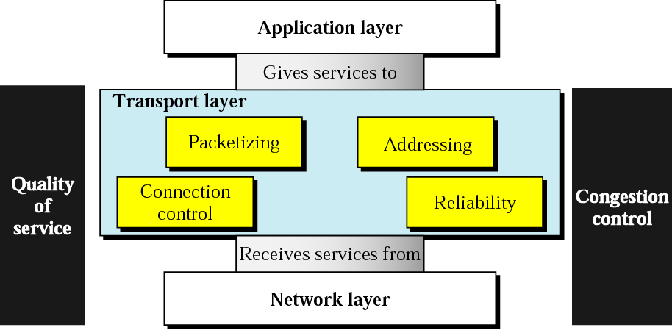
Transport Layer

Slide 3
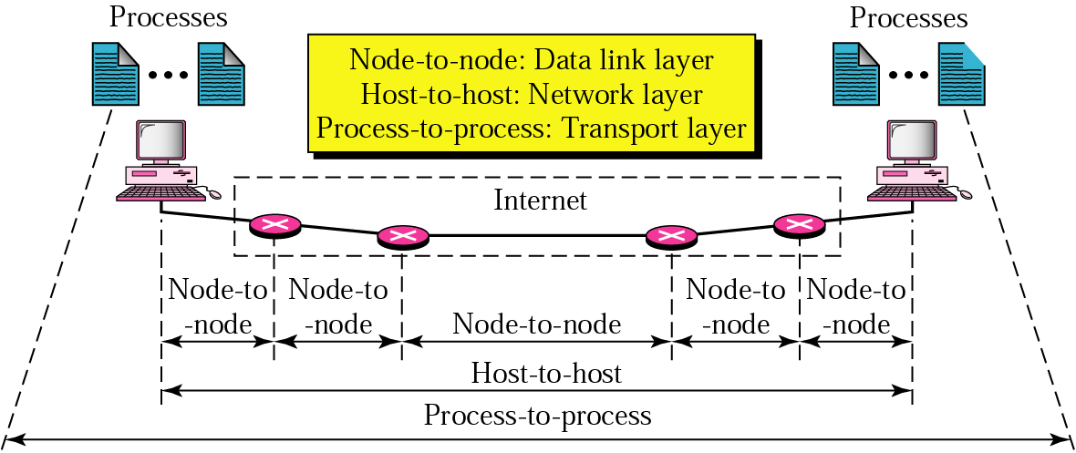
Transport Layer
Process-to-process delivery

Slide 4
Transport Layer Addressing
Addresses
Data link layer → MAC address
Network layer → IP address
Transport layer → Port number (choose among multiple processes running on destination host)

Slide 5
Transport Layer and Data Link Layer

Slide 7
Service Points

Slide 9
Transport and Data Link Error Control

Slide 10
Sequence Control

Slide 11
Loss Control

Slide 12
Duplication Control

Slide 13
Sliding Window

Slide 14
Multiplexing

Slide 15
Transmission Control Protocol (TCP)
TCP was specifically designed to provide a reliable, end-to-end byte stream over an unreliable internetwork.
Internetwork – different parts may have widely different topologies, bandwidths, delays, packet sizes and other parameters
TCP dynamically adapts to properties of the internetwork and is robust in the face of many kinds of failures.
RFC 793 (September 1981) – Base protocol
RFC 1122 (clarifications and bug fixes), RFC 1323 (High performance), RFC 2018 (SACK), RFC 2581 (Congestion Control), RFC 3168 (Explicit Congestion Notification)

Slide 16
TCP provides a connection-oriented, reliable, byte stream service.
Connection: TCP provides connections between clients and servers. A TCP client establishes a connection with a server, exchanges data across the connection, and then terminates the connection.
The term connection-oriented means that the two applications using TCP must establish a TCP connection by contacting each other before they can exchange data.
There are exactly two endpoints communicating with each other on a TCP connection; concepts such as broadcasting and multicasting are not applicable to TCP.

Slide 17
Reliable
Byte stream is broken up into chunks which are called segments
TCP requires acknowledgment when sending data. Receiver sends acknowledgements (ACKs) for segments
If an acknowledgment is not received, TCP automatically retransmits the data and waits a longer amount of time. TCP maintains a timer. If an ACK is not received in time, the segment is retransmitted
Detecting errors:
TCP has checksums for header and data. Segments with invalid checksums are discarded
Each byte that is transmitted has a sequence number

Slide 18
Byte Stream
TCP provides a byte stream abstraction to applications that use it. i.e. A TCP connection is a byte stream, not a message stream
Message boundaries are not preserved end-to-end i.e., no record markers or message boundaries are automatically inserted by TCP.
A record marker corresponds to an indication of an application’s write extent.
If the application on one end writes 10 bytes, followed by a write of 20 bytes, followed by a write of 50 bytes, the application at the other end of the connection cannot tell what size the individual writes were.

Slide 19
Transmission Control Protocol -TCP
Connection oriented Reliable stream transport
Full duplex virtual circuit
Conceptually place call, two ends communicate to agree on details
After agreeing application notified of connection
During transfer, ends communicate continuously to verify data received correctly
When done, ends tear down the connection
If UDP is like regular mail, TCP is like phone call
Provides buffering and flow control
Takes care of lost packets, out of order, duplicates, long delays
Isolates application program from network details

Slide 20
Transmission Control Protocol (TCP)
Round-trip time (RTT): TCP estimates RTT between a client and server dynamically so that it knows how long to wait for an acknowledgment.
Sequencing: TCP associates a sequence number with every byte (segment, unit of data that TCP passes to IP.) it sends. TCP reorders out-of-order segments and discards duplicate segments.
Flow control

Slide 21
TCP Service Model
Uses Sockets to define an end-to-end connection (Source IP, Source Port, Source Initial Sequence Number, Destination IP, Destination Port, Destination Initial Sequence Number)
Unix Model of Socket Implementation:
A single daemon process, called Internet Daemon (inetd) runs all the times at different well known ports, and wait for the first incoming connection
When a first incoming connection comes, inetd forks a new process and starts the corresponding daemon (for example httpd at port 80, ftpd at port 21 etc.)

Slide 22
TCP layering
App.
Port 1
Port 2
Port 1
Port 2
Demux on
Port number
Transport
TCP
UDP
A connection needs:
Source: (address, port) AND Destination: (address, port)
Only need one port on host to allow multiple connections, since each connection will have different (host, port) at other end
E.g. single host can serve multiple telnet connections
Passive open: application contacts OS & indicates it will accept incoming connection, OS assigns port and listens
Active open: application requests OS to connect to an (host, port)
Demux on IP protocol
IP port 6
Network
IP

Slide 23
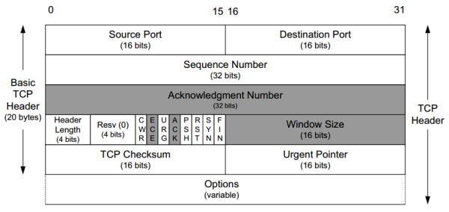
The TCP Protocol – The Header

Slide 24
Field Purpose
Source Port Identifies originating application
Destination Port Identifies destination application
Sequence Number Sequence number of first octet in the segment
Acknowledgment # Sequence number of the next expected octet (if ACK flag set)
Len Length of TCP header in 4 octet units
Flags TCP flags: SYN, FIN, RST, PSH, ACK, URG,CWR,ECE
Window Number of octets from ACK that sender will accept
Checksum Checksum of IP pseudo-header + TCP header + data
Urgent Pointer Pointer to end of “urgent data”
Options Special TCP options such as MSS and Window Scale

Slide 25
CWR- Congestion Window Reduced (the sender reduced its sending rate)
ECE- ECN Echo (the sender received an earlier congestion notification)
URG - Makes the Urgent Pointer field significant.
ACK - Makes the Acknowledgement Number field significant.
PSH - The Push Function causes TCP to promptly deliver data.
RST - Reset the connection.
SYN - Synchronize sequence numbers.
FIN - No more data from sender, but can still receive data.

Slide 26
Each TCP header contains the source and destination port number.
The source and destination port number, along with the source and destination IP addresses in the IP header, uniquely identify each connection.
The combination of an IP address and a port number is sometimes called an endpoint or socket .

Slide 27
TCP Sequence Number and Acknowledgement Number
32 bits sequence number and acknowledgement number
Every byte on a TCP connection has its own 32 bit sequence number – a byte stream oriented connection
TCP uses sliding window based flow control – the acknowledgement number contains next expected byte in order, which acknowledges the cumulative bytes that has been received by the receiver.
ACK number 31245 means that the receiver has correctly received up to 31244 bytes and expecting for byte 31245

Slide 28
TCP Segments
The sending and receiving TCP entities exchange data in the form of segments.
A TCP segment consists of a fixed 20 byte header (plus an optional part) followed by zero or more data bytes.
TCP can accumulate data from several write() calls into one segment, or split data from one write() into multiple segments
A segment size is restricted by two parameters
IP Payload (65515 bytes)
Maximum Transmission Unit (MTU) of the link

Slide 29
How a TCP Segment is Created
Write() calls from the applications write data to the TCP sender buffer.
Sender maintains a dynamic window size based on the flow and congestion control algorithm
Modern implementations of TCP uses path MTU discovery to determine the MTU of the end-to-end path (uses ICMP protocol), and sets up the Maximum Segment Size (MSS) during connection establishment
May depend on other parameters (buffer implementation).
Check the sender window after receiving an ACK. If the window size is less than MSS, construct a single segment; otherwise construct multiple segments, each equals to the MSS

Slide 30
Challenges in TCP Design
Segments are constructed dynamically, so retransmissions do not guarantee the retransmission of the same data segment – a retransmission may contain additional data or less data
Segments may arrive out-of-order. TCP receiver should handle out-of-order segments in a proper way, so that data wastage is minimized.

Slide 31
Window Size field in the TCP Segment Header
Flow control in TCP is handled using a variable sized sliding window.
The window size field tells how many bytes the receiver can receive based on the current free size at its buffer space.
TCP Acknowledgement – combination of acknowledgement number and window size

Slide 32
TCP header fields
Options:

Slide 33
TCP header fields
Options:
NOP is used to pad TCP header to multiples of 4 bytes
Maximum Segment Size
Window Scale Options
Increases the TCP window from 16 to 32 bits, I.e., the window size is interpreted differently
This option can only be used in the SYN segment (first segment) during connection establishment time
Timestamp Option
Can be used for roundtrip measurements

